Slide 1


Arduino Soil Sensors Project
This project incorporates an Arduino ATmega, soil moisture sensor, soil temperature sensor, and DHT11 sensor to monitor and analyze soil conditions, enhancing agricultural practices and environmental understanding.

Slide 2

Project Overview
This project aims to provide valuable data for agricultural monitoring by utilizing Arduino technology for real-time analysis of soil conditions.
Objective
Components Used
Benefits
To use Arduino to create a project that monitors soil moisture, temperature, and humidity.
Includes Arduino ATmega, soil moisture sensor, soil temperature sensor, and DHT11 sensor.
Help optimize irrigation practices and improve crop yields.

Slide 3


Arduino ATmega Overview
1
Introduction to ATmega
2
Programability
3
Power Consumption
The ATmega series from Microchip Technology, particularly ATmega328, is widely used in Arduino boards, making it ideal for DIY projects.
It can be programmed with the Arduino IDE, allowing easy code writing and uploading for various sensor interactions.
The ATmega is energy efficient, making it suitable for long-term outdoor applications with battery power.

Slide 4



Soil Moisture Sensor
Data Interfacing
2
It outputs an analog voltage based on moisture levels, which can be read by the Arduino for processing.
Functionality
This sensor measures the volumetric water content in the soil, which is essential for determining when to irrigate.
1
Applications
3
This sensor is particularly useful in precision agriculture and automated irrigation systems, preventing over and under-watering.

Slide 5


Soil Temperature Sensor
Measurement Capabilities
Impact on Growth
Data Integration
Provides real-time data on soil temperature.
Essential for seed germination and plant development.
Combines temperature data with moisture levels.

Slide 6



DHT11 Sensor Overview
Limitations
2
While DHT11 is cost-effective, it has limitations in accuracy and range, making it suitable for hobby projects but less ideal for professional agriculture.
Humidity and Temperature Measurement
1
The DHT11 sensor provides accurate readings of both air temperature and relative humidity, which are important factors for plant health.
Integration
3
The integration of DHT11 data enhances the ability to monitor environmental conditions along with soil metrics.

Slide 7
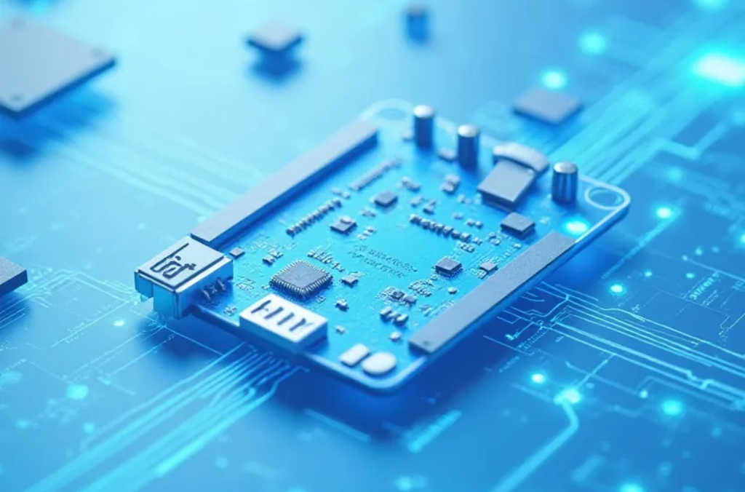


Data Processing and Analysis
Data Collection
Visualization
Feedback Mechanism
The Arduino collects data from all sensors at regular intervals, storing it for analysis and monitoring.
Using software like Processing or MATLAB, data can be visualized to track changes over time and observe trends.
The system can be designed to provide automated feedback for irrigation control, optimizing water usage based on real-time data.

Slide 8



Project Conclusion
Future Enhancements
Further improvements could include wireless data transmission and integration with IoT for remote monitoring.
2
Project Significance
This Arduino project showcases how technology can enhance traditional agriculture practices through improved data collection and analysis.
1
Educational Value
This project serves as an excellent educational tool, demonstrating practical applications of electronics and programming in environmental science.
3

